Slide 1
JustPicked
Team E Pitch Slides
Zenix Teo
Lim Wee Liang Kelven
Tay Gao Jun
Syed Packir Mohamed Synul Banu
Jonita Limbu
Notes:
Lim Wee Liang Kelven, S10221788K

Slide 2
Table of Contents
1. FDQ
2. Real stories
3. Stakeholders
4. Problem
5. Overall Concept of Solution
6. Demo
7. Key Benefits of Solution
8. Feasibility
9. How our Solution solves the Problems
10. References
11. Q&A
12. Reflection
Notes:
Lim Wee Liang Kelven, S10221788K
Here are the topics we will be covering in this presentation.

Slide 3

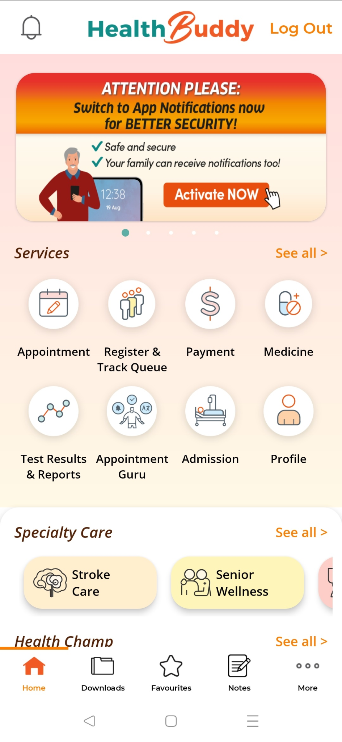


Rationale behind the change of FDQ
Existing Solutions
Initial FDQ: How can we ensure most low-income elderly in Singapore have access to affordable and quality healthcare?
Healthcare market is too saturated.
Too many existing solutions.
Changed to foods along with technology.
Notes:
Lim Wee Liang Kelven, S10221788K
Our initial FDQ was: How can we ensure most low-income elderly in Singapore have access to affordable and quality healthcare?
We decided to change FDQ because after rounds of brainstorming, we found out that the healthcare market is too saturated and there are too many existing solutions that disjoint our solution.
Hence, we decided to venture into the food market along with technology.

Slide 4

New FDQ
How can we ensure low-income families in Singapore have access to currently existing affordable and quality food?
Notes:
Lim Wee Liang Kelven, S10221788K
Our new FDQ is: How can we ensure low-income families in Singapore have access to currently existing affordable and quality food?

Slide 5
Experiences regarding food items & finances
Mdm. Fatima
… divorced and lives in a 2-room HDB rental together with her 2 daughters and 1 granddaughter … earns $1,300 per month … often ends up working overtime … budgets for monthly rental ($153), school pocket money for the three girls, EZ-Link top-ups, utility bills and groceries … no family support
Ms. Chen
… living in a 1-room HDB flat with her infant son … works part-time in a coffee shop, earning $650 monthly … Half her income goes on rent and utilities … feels financially stretched every month … no family support … depends on canned food, noodles and cereal … saves the food available at home for her child … embarrassed and ashamed …
Notes:
Syed Packir Mohamed Synul Banu, 10226858G
Here are some real stories from low-income individuals
MDM. FATIMA, 47
Mdm. Fatima is divorced and lives in a 2-room HDB rental together with her two younger daughters (ages 17 and 14) and a granddaughter (age 12). Since her eldest daughter (age 30) has had a history of incarceration, Mdm. Fatima prefers to keep her grandchild with her. She works as a cleaner in a private condominium, earning $1,300 per month. She often ends up working overtime to supplement her income as it is not enough to meet the needs of her family. She budgets for monthly rental ($153), school pocket money for the three girls, EZ-Link top-ups, utility bills and groceries, among other expenses, to support the family of four. She has no family support. Her elder brother used to support her with a monthly allowance, but he has stopped as he has financial problems of his own. Mdm. Fatima did get some monthly support ($300/ month) from Majlis Ugama Islam Singapura when she was out of work, but that has stopped. “The only way I can better my family’s situation is to work hard so that the girls can get a good education and good job. I only study till Primary 3, so I’m a cleaner. I don’t want the girls to do the same. One day they will get a good job and earn, and I can rest.”
MS. CHEN Age: 36 years Ms. Chen has been living in a 1-room HDB flat with her infant son after her child’s father left her. She works part time in a coffee shop, earning $650 monthly to afford daily essentials such as rent, utilities and milk powder. Half her income goes on rent and utilities. With a limited income, she feels she has to prioritise what she needs to pay for monthly. Even though she receives $200 in support from the government, she worries about her bills and feels financially stretched every month. “Sometimes the nursery teacher called to buy something for the baby to take shower, the baby is so small, and we don’t want people to say that he is wearing broken clothes and pants.” She is relieved to be currently receiving some form of support from various sources. She is grateful to have received support from her MP in the form of milk powder and diapers. Once a year, she receives food support in the form of cookies, Milo and nuts from a church organisation. Ms. Chen’s son attends the neighbourhood nursery. Her neighbours pitch in to help watch over her son whenever she goes to work. As she does not have the time to cook at home because of caregiving responsibilities, she depends on canned food, noodles and cereal. At times, she saves the food available at home for her child instead of consuming it herself, leaving her hungry. She highlighted feeling embarrassed and ashamed as a result of having inadequate food for herself. She perceives her physical and mental health to have suffered as a result of her lack of access to adequate and nutritious food. At times, she highlighted having difficulty concentrating or focusing on tasks.

Slide 6










Stakeholders
Consumers (Low-Income Families)
Supermarkets
Govt & NGOs
Delivery & Logistics
App developers & Investors
Notes:
Syed Packir Mohamed Synul Banu, 10226858G
Our stakeholders include:
Consumers, primarily those from low-income families
Supermarkets such as FairPrice, ColdStorage, and Sheng Siong
Government and NGOs such as Food Bank and NVPC
Delivery and logistics companies like Ninja Van, RedMart, and QXpress
App developers and investors

Slide 7
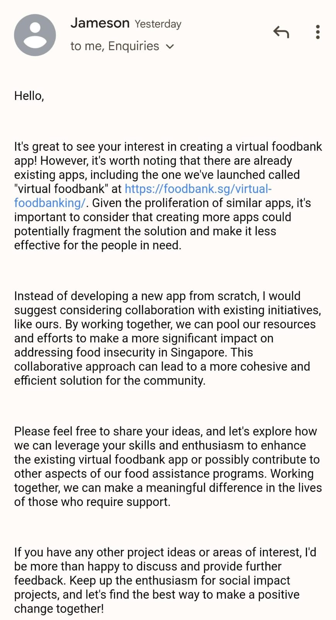
Feedback from Foodbank
Summary:
- Suggested to collaborate with existing initiatives
- More impact on addressing food insecurity
- More cohesive & efficient solution
- Foodbank is open for collaboration
What we changed after this feedback:
- Looking to collaborate with numerous supermarkets and assistance schemes
- Looked into ways to address food insecurity
Notes:
Syed Packir Mohamed Synul Banu, 10226858G

Slide 8






Current Problems
Limited Access
Price Transparency
Time Constraint
Poor Budget Management
Inflation
Transportation Costs
Notes:
Jonita S10222578D
The first problem low-income families face is accessing affordable and quality groceries, leading to potential food insecurity, malnutrition, and limited awareness of ongoing promotions and most budget friendly items.
There is also a lack of price transparency. Some supermarkets may not openly display their promotions or competitive pricing, making it challenging for consumers, especially low-income individuals, to find the best deals.
Full-time working adults may have insufficient time for grocery shopping due to juggling multiple jobs and caregiving responsibilities. If they have time, they might visit multiple supermarkets to find affordable options. This is an inefficient shopping practice, it is time-consuming and impractical.
Some individuals may have poor budget management. Without access to price comparison tools, they may struggle to budget effectively and stretch their dollar.
With inflation worsening, high grocery costs can contribute to financial stress and affect budgeting, such as housing, education, and healthcare.
Low-income families who live in areas with limited access to affordable groceries may need to travel further leading to high transportation costs.

Slide 9

Overall Concept
JustPicked provides access to affordable and quality groceries for low-income families in Singapore.
By aggregating prices and promotions from supermarkets, it empower users to choose the most budget-friendly options.
Bridging the gap between low-income families and affordable groceries, promoting better access to essential food items and improving overall well-being.
Notes:
Jonita S10222578D
To sum it all up,
JustPicked provides access to affordable and quality groceries for low-income families in Singapore.
By aggregating prices and promotions from various supermarkets, the app empowers users to make informed decisions and choose the most budget-friendly options along with delivery and potential cashbacks.
It bridges the gap between low-income families and affordable groceries, promoting better access to essential food items and improving overall well-being.

Slide 10



Key Benefits of JustPicked
Cost-Saving
& Cashback
Saves Time
Social Impact
Increases Traffic to Supermarkets
Convenience &
Accessibility
Reduces
Food Waste
Notes:
[ Tay Gao Jun, S10227533B ]
Here are the key benefits of our solution.
Cost-Saving & Cashback
Users can compare prices and promotions from various supermarkets, ensuring they get the best deals and save money on their grocery purchases. As well as subsidies, vouchers and even point reward system to help.
Convenience and Accessibility
The app empowers low-income families with access to affordable and quality groceries, reducing financial strain and promoting food security.
Saves Time
JustPicked eliminates the need for users to visit multiple supermarkets physically. They can shop from the comfort of their homes and have groceries delivered to their doorstep.
Users save time by using the app's price comparison feature, quickly identifying the most cost-effective options without extensive research.
Reduces Food Waste
The app's feature of showcasing perishable items' best deals can help reduce food waste, as users can purchase products before they spoil.
Social Impact
JustPicked aims to address food insecurity and financial challenges faced by low-income families by providing free delivery and potential cashback incentives to eligible users, making a positive impact on vulnerable communities.
Increases Traffic to Supermarkets
JustPicked can drive more customers to supermarkets, especially price-conscious shoppers seeking the best deals, thus benefiting the retail industry.

Slide 11
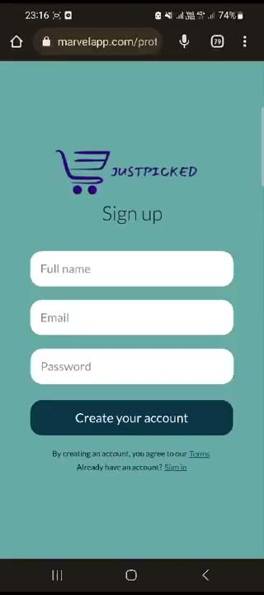
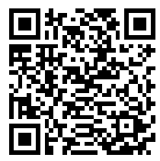
Demo
Notes:
[ Tay Gao Jun, S10227533B ]
We will now be proceeding with a short demonstration of our solution and its key features.

Slide 12


Feasibility
8/10
8/10
Technicality | Operational
User-Friendly Interface Simple, easy navigation Real-Time Data Integration Up-to-date information Scalability Scalable to meet high customer traffic Mobile Compatibility Available on IOS and Android | Supermarkets Partnerships Accurate price comparisons Delivery and Logistics Integration Reliable and efficient Customer Support Enhance user satisfaction
Notes:
Zenix Teo, S10204049C
Technical
User-Friendly Interface: The app's design focuses on simplicity and ease of use, ensuring that users of all ages and technological backgrounds can navigate it effortlessly.
Real-Time Data Integration: JustPicked can partner with supermarkets and utilize their APIs to access real-time pricing and promotion data, ensuring accurate and up-to-date information for users.
Scalability: The app's architecture is built to handle a growing user base and increasing demands, making it scalable as the number of users and supermarkets increases.
Mobile Compatibility: JustPicked can be developed for both Android and iOS platforms, ensuring accessibility to a wide range of smartphone users.
Operation Feasibility:
Supermarkets Partnerships: Building partnerships with major supermarkets is crucial for the app's success. JustPicked can collaborate with supermarkets to access their product data and ensure accurate price comparisons.
Delivery and Logistics Integration: By partnering with existing delivery and logistics services, JustPicked can streamline the delivery process and offer users reliable and efficient delivery options.
Customer Support: Establishing a customer support team ensures prompt resolution of any user issues, enhancing user satisfaction and retention.
One of our teammates, Kelven, studies database. First, we will add all the products and prices into a database via a pipeline connection. The app will then display the products using this database.

Slide 13



Feasibility
Economic | Funding | Practicality
Revenue Model Small commission fee from each purchase Cost-Effective Development Easy to add more products/shops | Initial Investment Angel investors and venture capitalists Crowdfunding Socially-conscious consumers | User Registration and Verification SingPass integration Payment Integration Seamless transactions Marketing and Outreach Communities, NGOs, Government
7/10
8/10
9/10
Notes:
Zenix Teo, S10204049C
Economic Feasibility
Revenue Model: JustPicked can adopt a revenue model based on a small commission from each purchase made through the app. This model ensures that the app remains economically viable while providing value to users and supermarkets.
Cost-Effective Development: Advances in app development tools and technologies make it cost-effective to create and maintain the JustPicked app, minimizing initial investment and ongoing expenses.
a commission rate ranging from 5% to 10% could be a reasonable starting point. However, the best commission rate will ultimately depend on the specific dynamics of the app, the response from partner supermarkets, and the app's ability to maintain its social impact mission while generating sustainable revenue. As the app gains traction and establishes successful partnerships, you may refine the commission rate based on real-world feedback and performance.
Funding Feasibility
Initial Investment: The development and launch of the JustPicked app can be supported by initial funding from grants, angel investors, or venture capital firms interested in social impact and innovative solutions.
Crowdfunding: The app's concept aligns with the interests of socially-conscious consumers, making crowdfunding campaigns a viable option to raise additional funds.
Government Funding: Many governments around the world have initiatives and grant programs that support innovative projects focused on sustainability, environmental conservation, and technology. In Singapore, for example, there are various government agencies like Enterprise Singapore and the National Environment Agency (NEA) that offer funding opportunities for startups and projects that promote environmental sustainability and waste reduction. Collaborating with the government can provide financial support, regulatory assistance, and access to resources that can help your app grow and achieve its objectives.
Supermarket Funding: Supermarkets, especially those with a focus on corporate social responsibility (CSR) and sustainability, may also be interested in funding projects that align with their values and contribute to environmental causes. As your app aims to encourage glass bottle recycling and promote a circular economy, supermarkets with similar objectives may see the value in supporting your initiatives. Funding from supermarkets can provide financial support for the app's development, marketing, and ongoing operations. Additionally, supermarkets may collaborate with your app to offer exclusive promotions and rewards to app users, further incentivizing participation and engagement.
rough estimate, a social impact-focused mobile app development project in Singapore can typically range from SGD 50,000 to SGD 150,000 or more, depending on its complexity and scale. This estimation includes app development costs, marketing expenses, server hosting fees, team salaries, and potential contingencies.
Practical Feasibility
User Registration and Verification: To implement the free delivery and cashback benefits for low-income users, the app can require income verification during the registration process.
Payment Integration: Secure and convenient payment gateways can be integrated into the app to facilitate seamless transactions.
Marketing and Outreach: JustPicked can conduct marketing campaigns to raise awareness among low-income communities, collaborating with NGOs and government agencies to reach the target audience effectively.

Slide 14



How JustPicked solves the current problems
Reduced Transportation Costs
Access to Affordable & Quality Groceries
Price Transparency
Time-Efficient Shopping
Improved Budget Management
Free Delivery & Cashback
How can we ensure low-income families in Singapore have access to currently existing affordable and quality food?
Notes:
Zenix Teo, S10204049C
Access to Affordable and Quality Groceries:
The app compares prices and promotions from various supermarkets, allowing users to identify the most budget-friendly options without compromising on the quality of groceries.
Price Transparency:
JustPicked ensures price transparency by aggregating real-time data from partner supermarkets, making it easy for users to find the best deals and promotions available.
Time-Efficient Shopping:
Instead of visiting multiple supermarkets physically, users can use JustPicked to quickly compare prices and promotions in one place, saving time and effort.
Improved Budget Management:
With access to price comparison tools, low-income families can make informed decisions, stretching their budgets and maximizing the value of their available funds.
Alleviating financial strain, allowing them to allocate funds to other essential expenses like housing, education, and healthcare.
Reduced Transportation Costs:
By providing information on budget-friendly items and promotions from nearby supermarkets, the app minimizes the need for low-income families to travel long distances, thus reducing transportation costs.
Free Delivery and Cashback:
JustPicked offers free delivery and potential cashback to eligible low-income users, easing their financial burden and providing additional savings.
All of these are interconnected to help combat the FDQ of How can we ensure low-income families in Singapore have access to currently existing affordable and quality food?
Each feature plays a part to create a comprehensive and cohesive solution to this FDQ.

Slide 15
Thanks!
Q&A
Notes:
Zenix Teo, S10204049C
Thank you for listening, we will now be proceeding to the Q&A

Slide 16
References
https://foodbank.sg/wp-content/uploads/2022/03/The-hunger-report_-An-in-depth-look-at-food-insecurity-in-Singapo.pdf
Notes:
Here are our references

Slide 17
Tay Gao Jun | CSF | 150 Words
Working in multidisciplinary teams has helped me to appreciate the value of different perspectives. For example, our project, the business analytics student in our team, Zenix, has provided us with valuable insights from what he learned from his marketing and entrepreneurship modules. These insights helped us to further enhance our solution and make it more feasible.
I believe that the ability to work effectively in multidisciplinary teams will be a valuable asset in my future career. In today's world, most challenges require a solution that draws on the expertise of people from different disciplines. By learning how to collaborate effectively with others, I will be better equipped to tackle complex problems and develop more creative solutions.
I am grateful for the opportunity to have worked with such a talented and diverse group of students. I am confident that the skills I learned will be helpful to me in the future.
Notes:
Roles :
Making of first prototype with Kelven
Making of second prototype with Jonita
Assist with Prototype Slides

Slide 18
Zenix | BA | 150 Words
As the project manager and leader in a multi-disciplinary team, working with teammates from IT and Nursing courses was a transformative experience. My key takeaway is the importance of leveraging diverse expertise to create a comprehensive solution. During the design phase, the IT students brought technical knowledge to develop the user-friendly "JustPicked" app. The Nursing students provided insights into the needs of low-income families, ensuring the app's relevance and impact.
This takeaway will be invaluable in my future pursuits. In further studies, I'll prioritize collaboration, enhancing problem-solving skills across disciplines. During internships and employment, leading diverse teams will create dynamic solutions to real-world challenges. In my career, leveraging diverse expertise will lead to better decisions, fostering efficient and impactful projects. This experience has enriched my leadership capabilities, preparing me to thrive in the dynamic business landscape. I look forward to applying these skills and drive positive change through collaborative leadership.
Notes:
Roles:
Leading the team
Allocating roles
Marketing
Pitch Slides
Planning of Prototype components

Slide 19
Lim Wee Liang Kelven | DS | 142 Words
My key takeaway from this project is the power of diverse perspectives. Collaborating with individuals from different fields brought abundant ideas, expertise, and problem-solving approaches, leading to a more holistic and innovative solution. I learnt the importance of effective communication, active listening, and adaptability to different working styles. Zenix was a great help in drafting the pitch since he studies business.
This experience will be tremendously helpful in future endeavours. In further studies, I can apply the same collaborative approach to tackle complex problems and enrich my academic experience. I can readily adapt to diverse teams and contribute effectively during internship placements. In finding employment, working seamlessly with colleagues from various backgrounds will make me a valuable asset to any organisation. This takeaway will empower me to craft innovative and well-rounded solutions to address challenges and foster continuous growth in my career.
Notes:
Aided in designing the first app prototype, and second draft of the pitch slides

Slide 20
Syed Packir Mohamed Synul Banu| NSG | 150 Words
One lesson we learned was the importance of working with a diverse team. By leveraging the unique skills and knowledge of members from various domains, we assigned tasks based on our strengths, resulting in increased efficiency overall. During the design phase, Zenix led the charge by creating a range of marketing materials. Additionally, Kelven and Gao Jun contributed valuable ideas and collaborated to create a prototype that was both functional and usable for our team.
I aim to develop effective solutions that simplify the daily task of my nursing colleagues and enhance the care of patients. To achieve this goal, I will work closely with a multidisciplinary team to develop innovative solutions that streamline the daily duties of my colleagues. By combining my healthcare expertise with the latest technological advancements, we can make a positive impact on the lives of our patients and improve the overall healthcare experience for everyone.

Slide 21
Jonita | NSG | 134 Words
Collaborating with a versatile multi-disciplinary team has taught me great preservation even when things are not flowing in the right direction. During our design phase, we struggled to invent a comprehensive solution which catered to our FDQ which was a difficult topic to counter. Hence we had to invent a new FDQ. Nonetheless, we maintained our preservation and work drive till the end. Additionally, I saw great improvement in our communication and teamwork from previous assessments done together.
This crucial takeaway has taught me the importance of resilience and communication and how this can be applied to my work ethics. When I become a staff nurse and am faced with challenges such as taking on multiple patients’ cases, I will be able to rely on my colleagues to help me and provide moral support.
Notes:
App designer

